Slide 1
Strengthening of Global Public Health surveillance through data and benefit sharing
Authors:
Michael Edelstein, Lisa M. Lee, Asha Herten-Crabb, David L. Heymann, David R. Harper
Affiliation:
Chatham House, London, UK
Walter Reed Army Institute of Research, Silver Springs, Maryland, USA
Shriyuta

Slide 2
Content
1) Summary
Sources of data
Key stakeholders
Benefits of data sharing
Principles of data sharing
2) Key points
3) Limitations of the paper
4) Implications in Indian context

Slide 3
Sources of data
Health system (both routine and non-routine data)
Non-health sector (Dept. of Animal Husbandry, Dairying and Fisheries)
Non-governmental organizations and international agencies
Academia
Online data (search engine and social media queries, crowd-sourced event-based information queries, machine learning, natural language processing, and geolocalization)

Slide 4
Key stakeholders
Data providers (health facilities, lab networks, science and technology institutions)
Data interpreters (administration, technical experts)
Data users (academia, non-governmental organizations)
Data sharing facilitators (health intelligence agencies)
Beneficiaries (policy makers, end-users)

Slide 5
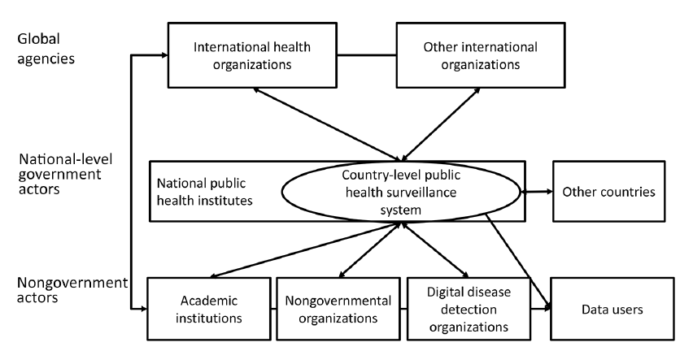
The global public health surveillance framework, 2018.

Slide 6
Why share data?
Benefits of sharing public health data outweighs the perceived harms associated with it.
Improve capacity for disease detection and response
e.g. Global Influenza Surveillance and Response Network (2003)
International support (technical and financial)
Coordinated public health response and improved risk management
Reduction in the scale of economic loss
Limited risk to travel and trade as opposed to popular beliefs

Slide 7
Principles of data sharing
Building trust
Articulating the value
Planning for data sharing
Achieving quality data
Understanding the legal context
Creating data sharing agreements
Monitoring and evaluation
Global Public Health Surveillance

Slide 8
Building trusts
Transparency in processes
Mutual benefits (data harvesting)
Accountability
Building and maintaining relationships
e.g. Mekong Basin Disease Surveillance Network, care.data in UK
Notes:
Trust-building measures sometimes take the form of face-to-face meetings, trans-national/regional workshops, desktop exercises, or joint outbreak investigations

Slide 9
Articulating the value
Articulation of benefits (equitable) and risks, so that all stakeholders are able to understand the value of sharing and how the data will be used.
Failure to reckon risks involved
e.g. care.data (England), ART database linked to Aadhar card
Sharing data during public health emergencies
e.g. West African Ebola outbreak (2014), Zika Open (2016)

Slide 10
Planning for data sharing
Plan for data sharing should be identified at the outset, which must benefit all stakeholders (for data access, visibility and dissemination)
Creating national public health indicators data base
e.g. Open Government Data initiative (India), Public Health outcomes framework (UK)
Sharing improves public health outcomes
e.g. Bangladesh Arsenic Mitigation Water Supply Project
Notes:
Must include:collection, processing, analysis, preservation, access, reuse, and disposal
Skill set-capacity
It is therefore felt by the Government that efficient sharing of data — among data owners and inter-and-intra governmental agencies along with data standards and interoperable systems — is the need of the hour. The objective is to facilitate access to government-owned shareable data (along with its usage information) in machine-readable form through a wide area network all over the country in a periodically updatable manner.

Slide 11
Achieving quality data
Sharing data (e.g. feedback, time-bound reporting) improves quality
Human errors, non-human errors
e.g. Google Flu Trends (2009,2013)
Using a facilitator to increase data quality
e.g. Worldwide Anti-Malarial Resistance Network
Notes:
relevance, accuracy, timeliness, accessibility, interpretability and coherence, Sharing data enables feedback and should therefore improve quality

Slide 12
Understanding legal context
Depends on issues such as geographical location, type of institution involved, type of data, level of public health threat, and other contextual factors. Parties must understand the legal implications and the legal tools available to facilitate the process
e.g. European Surveillance System

Slide 13
Creating data sharing agreements
Rights and interests of all the stakeholders must be taken into account
Depends of the level at which agreement is being made (international, national)
Understanding expectations leads to better agreements
Successful and sustainable data sharing agreements require the needs and expectations of all parties to be taken into account. Agreements drafted before the needs and expectations of all parties are understood can lead to inequities in benefit sharing.
Notes:
the recent SARS outbreak was seen by many to be a prime example of the negative aspects of globalisation—the rapid transmission of a new, fatal, infectious disease. However, it also showed the power that globalisation can bring to bear on dealing with such outbreaks. In a period of weeks from the first notification of the outbreak, the new virus was identified, its genome sequenced, surveillance of its spread coordinated internationally, cases quarantined, measures put in place to reduce transmission and infection, and by the end of three months the emergency was declared effectively over.

Slide 14
Monitoring and evaluation
As new sources of surveillance data emerge, and as data are successfully shared, case studies that demonstrate the positive impact of sharing data must be disseminated, impact of not sharing data must be told to.
Evaluating data reuse
e.g. MSF’s data sharing policy

Slide 15
Key points
Making data sharing in public health, a norm rather than an expectation by developing systems to overcome economic, ethical, legal and political obstacles.
Data sharing ensures improved public health action, comes with collateral benefits e.g. improvement in data quality, health system memory (scientific and operational), policy change
Helps in capacity building and improves policy implementation.
Notes:
identification of etiological factors, prediction of disease spread, evaluation of existing and novel treatments, symptomatic care and preventive measures, and the deployment of limited resources during emergencies

Slide 16
Limitations
Author fails to address possible challenges linked to multiple stakeholders involved, specially in the context of LMICs and MICs.
Global public health surveillance framework is too simplistic in terms of factors affecting surveillance on a global level.
Apart from the guiding principles, the author doesn’t suggest any other incentives that could be given to nations for data sharing during emergencies.
Notes:
international organizations could advocate that economic aid be given to countries affected byoutbreaks;
– organizations could consider creating funds,
administered by WTO on the basis of recommendations
fromWHO, which would be available
to help countries suffering economic losses
global trade, international trade agreements, and public health

Slide 17
Implications in Indian context
Learning from past experiences of global public health emergencies (Zika 2016)
Signatory to IHR (2005)
Assistance from WHO and CDC (Global Disease Detection Program)
Integrated Disease Surveillance Program (International commitments and lab networks)
National Data Sharing and Accessibility policy (2012)
Signatory to Sustainable development declaration; data sharing is crucial to achieve most of the goals including goal no. 3.
One health: Antimicrobial Resistance Surveillance Research Network, MoUs (Ministry of Agriculture) with Algeria, Mongolia, Vietnam pertaining to animal health
Notes:
rincipal and most visible program for developing and strengthening global capacity to rapidly detect, accurately identify, and promptly contain emerging infectious disease and bioterrorist threats that occur international.
he GDD program’s structure consists of Regional Centers located in every WHO region. Centers are responsible for disease surveillance and response in their respective areas. These regional centers are interconnected via the Global Outbreak Alert Response Network (GOARN), and they report gathered information to the GDD Operations center at CDC headquarters in Atlanta, Georgia
Doha Ministerial Declaration on
TRIPS and Public Health
(TRIPS and Public Health

Slide 18
Thank you.

